Slide 1
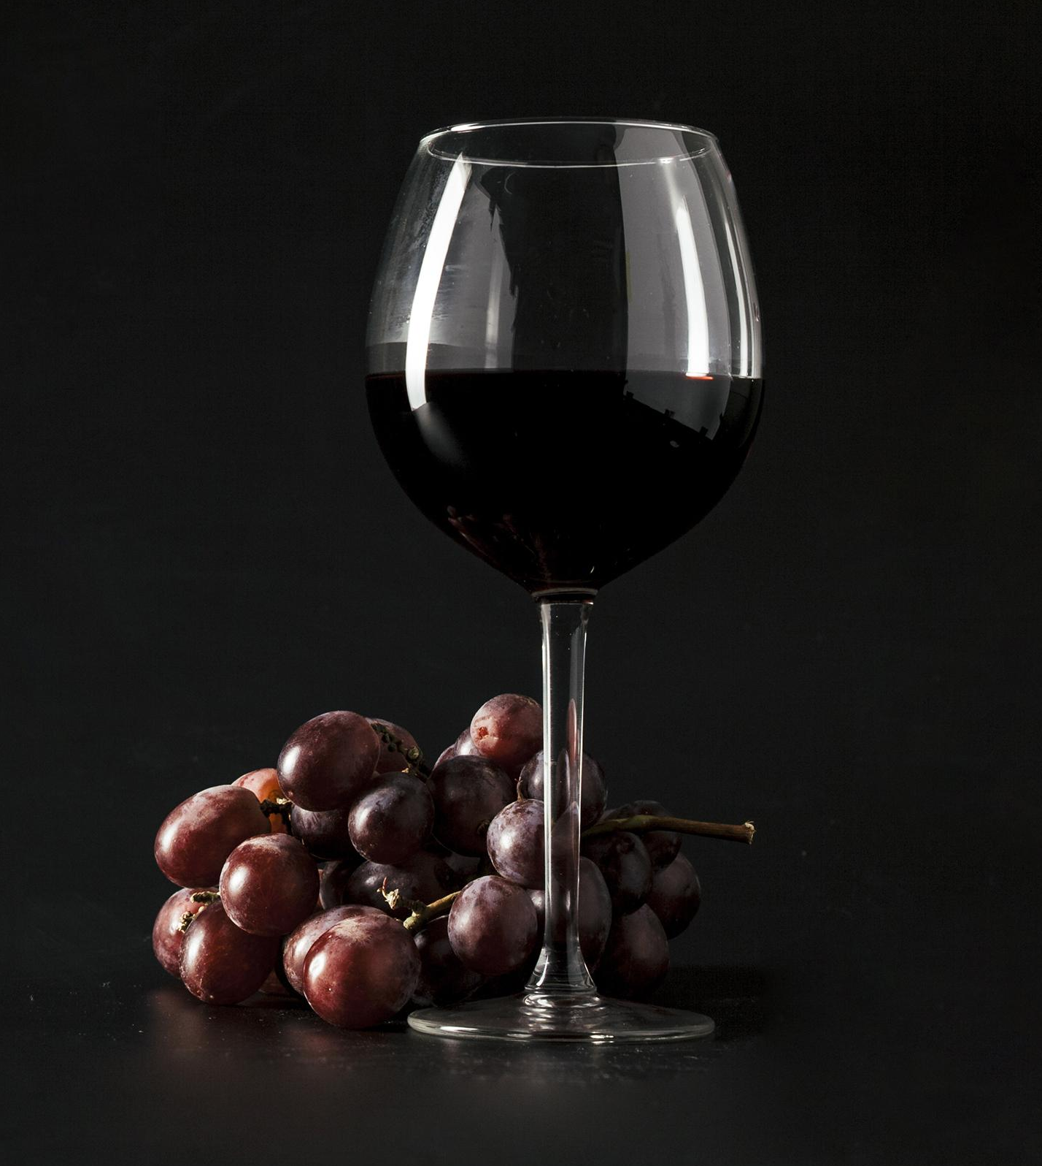


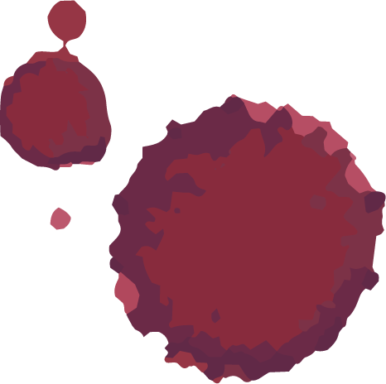
RED WINE QUALITY PREDICTION
Under the Guidance of :
A. Thanuja, M .Tech,(Ph.D.)
Submitted by :
Ch. Sai Sri Ram (19471A0573)
J. Avinash (19471A0579)
K. Raghu Ram Sri Rishik (19471A0585)
V. Narendra Reddy (19471A05C9)

Slide 2
CONTENT
Abstract
System Requirements
Existing & Proposed System
Pre-processing
Models & Testing
Screenshots of project
Conclusion
Future Scope

Slide 3
ABSTRACT
To analyze the quality of red wine before its consumption to preserve human health.
A number of variables affects the quality of prediction.
These considerations of different factors contribute to the prediction of red wine quality.
Using the machine learning algorithms, this study provides a computational intelligence approach for predicting the red wine quality.
The proposed research approach uses Support Vector Machine, Naive Bayes Algorithm and Random Forest Classifier
. We had used a red wine quality dataset for the prediction purpose, and machine learning methods are used to predict the quality by models comparing their accuracies.

Slide 4
OBJECTIVE
The objective of classifying quality of red wine are:
To classify the quality of red wine.
To give knowledge to the user about the properties of red wine.

Slide 5
Requirements
Software Requirements
Operating System : Windows 10
Coding Language : Python
Python Distribution : Anaconda, Flask
Browser : Any Latest Browser Like Chrome
Hardware Requirements
Processor : Intel Core i5
Hard Disk : 30GB or more
RAM : 4GB or more

Slide 6
Existing System :
Nowadays people try to lead a luxurious life. These days the consumption of red wine is very common to all.
So it became important to analyze the quality of red wine before its consumption to preserve human health
Dis Advantages :
Computation time is very high.
Lacking of accuracy may result in lack of efficient for further prediction.
Proposed System :
By using this system we can reduce its consumption, enhance quality. It is easier to predict the quality and it will also help to reduce the consumption.
Advantages :
Generates accurate and efficient results.
Computation time is greatly reduced.
Reduces manual work.

Slide 7
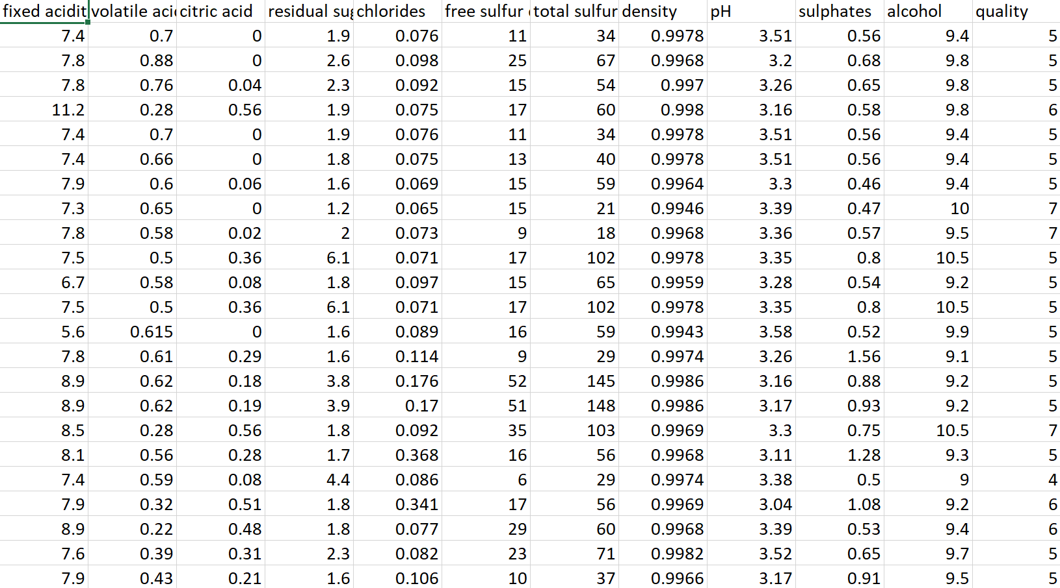
Data Set
The data set contains 12 attributes and 1599 records.
Here quality attribute is the target variable.

Slide 8
Pre-processing
Before feeding data to an algorithm we have to apply transformations to our data which is referred as pre-processing.
We observed that there are some outliers present, so we removed those unwanted data from the dataset.
After that, we mapped the values in the quality attribute to good and bad based on these values
Quality = (3,4,5) -> Bad
(6,7,8) -> Good

Slide 9
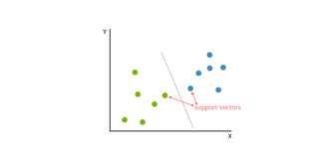
Support Vector Machine
Support vector machine is a linear model for classification and regression problems.
It is a supervised machine learning algorithm.
It can solve linear and non-linear problems and work well many practical problems.
SVM algorithm finds the closest point of the lines from both the classes.

Slide 10
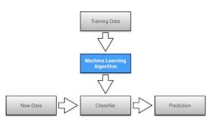
Naïve Bayes
It is a simple technique for constructing classifiers.
This classifiers used for solving classification problems.
All Naive Bayes classifiers assume that the value of any particular feature is independent of the value of any other feature.

Slide 11
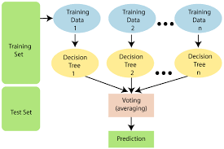
Random Forest Classifier
Random Forest is a popular machine learning algorithm that belongs to the supervised learning technique.
It can be used for both Classification and Regression problems in ML.
Random Forest is a classifier that contains a number of decision trees on various subsets of the given dataset and takes the average to improve the predictive accuracy of that dataset.

Slide 12
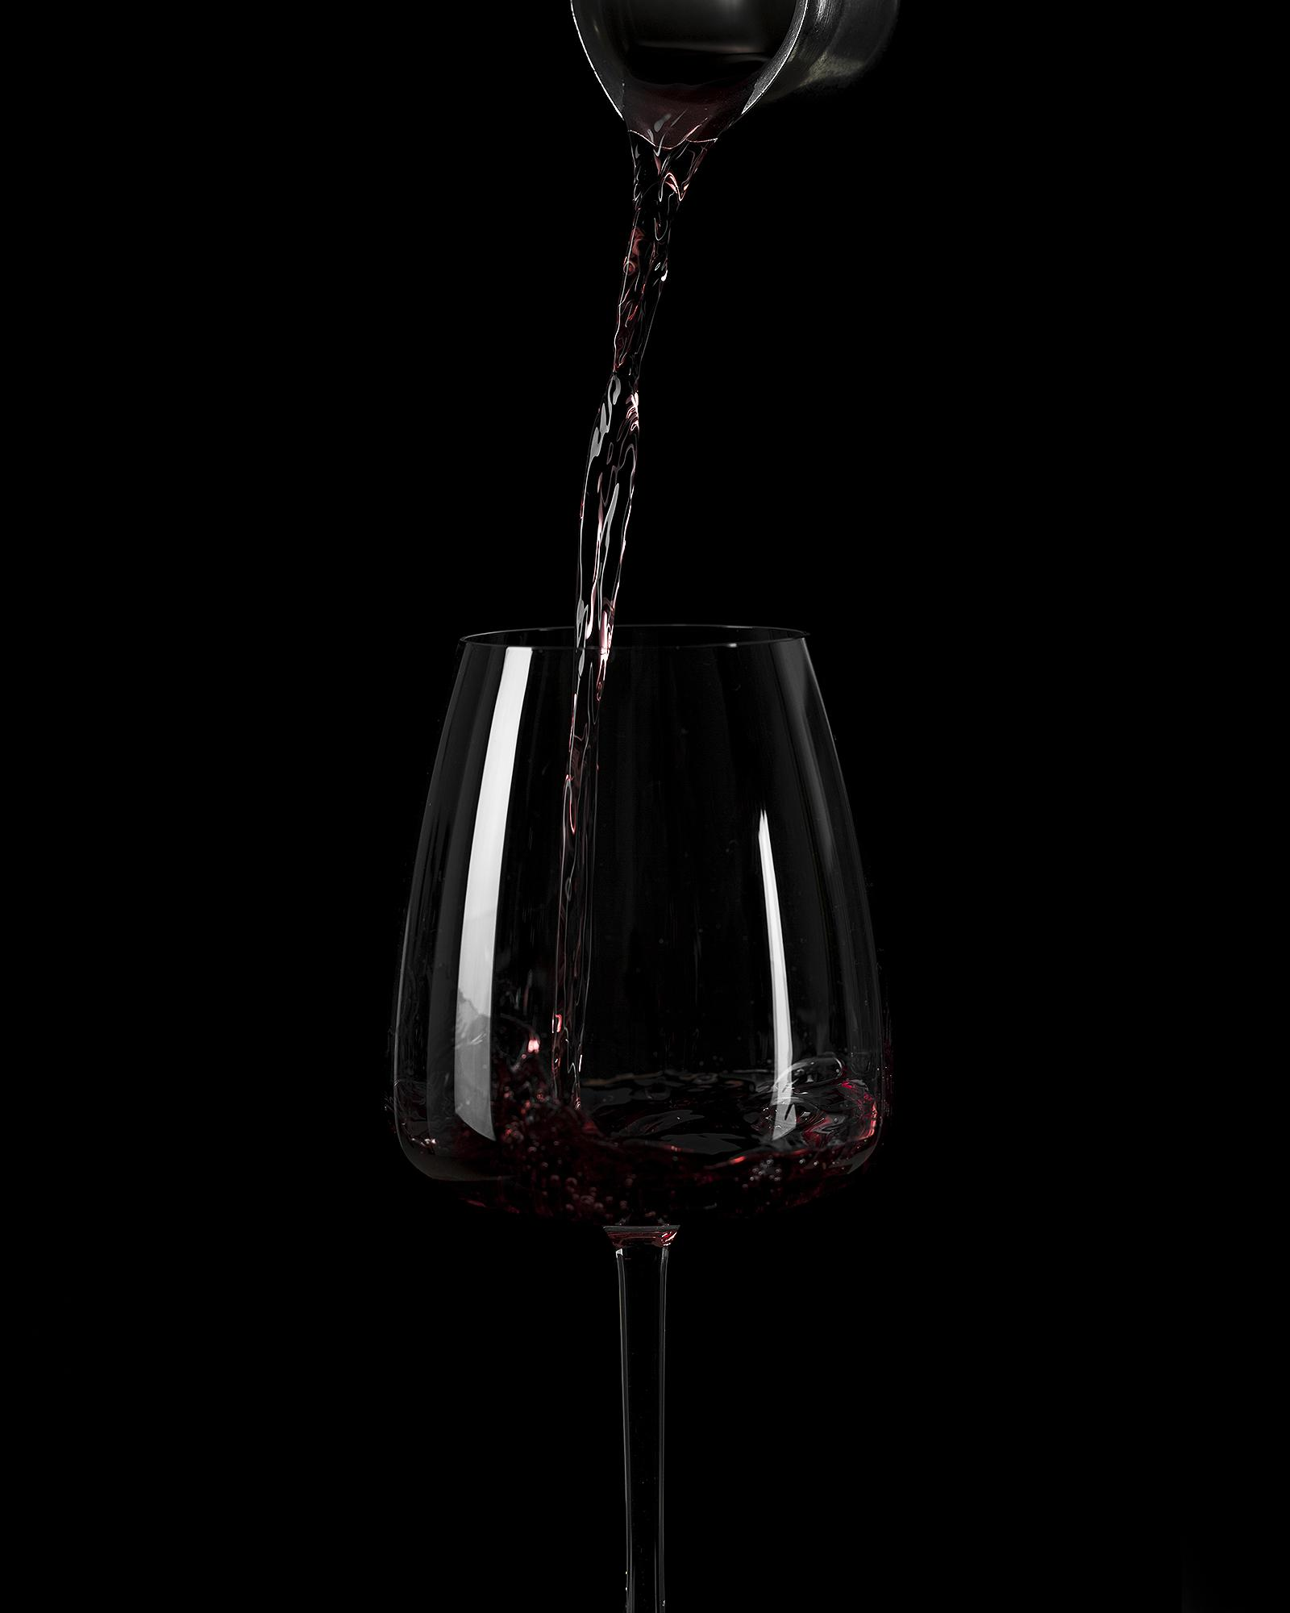

Accuracy of Support Vector Machine on red wine quality dataset is 56.8%
Support Vector Machine
Accuracy of Naïve Bayes Classifier on red wine quality dataset is 71.7%
Naïve Bayes Classifier
Accuracy of Random Forest Classifier on red wine quality dataset is 80.2%
Random Forest Classifier

Slide 13
Imported Modules
numpy : A python library used for working with arrays.
Pandas : A python library used to analyze the data.
Matplotlib : It is a graphical plotting library used for data visualizations.
Kfold : It is a validation technique used for splitting the data into k-subsets. Each of the k-
subsets used as test set and k-1 subsets for training set.

Slide 14
Output
Any sample quality can be predicted with the valid information.
The accuracy of the predicted quality is 80%

Slide 15
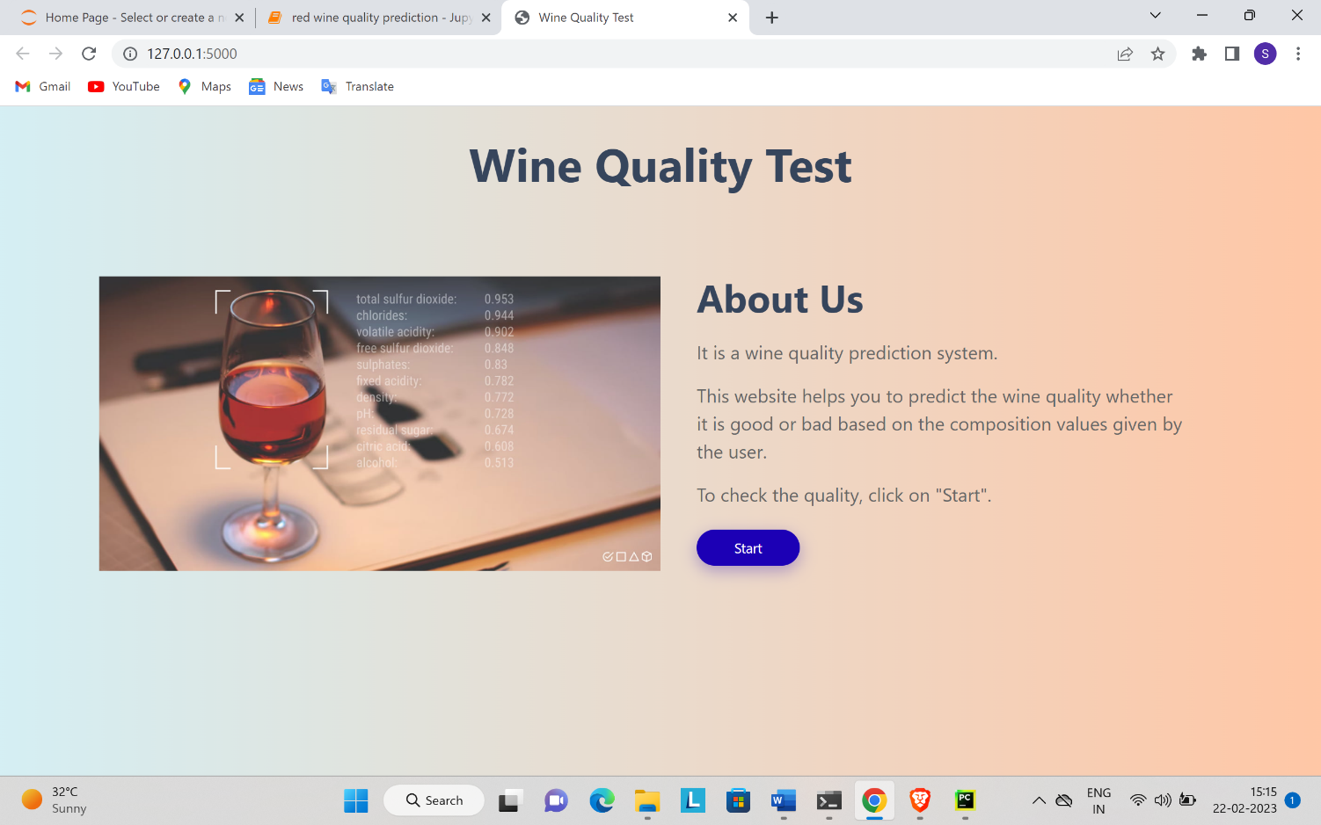
Screenshots of the project

Slide 16
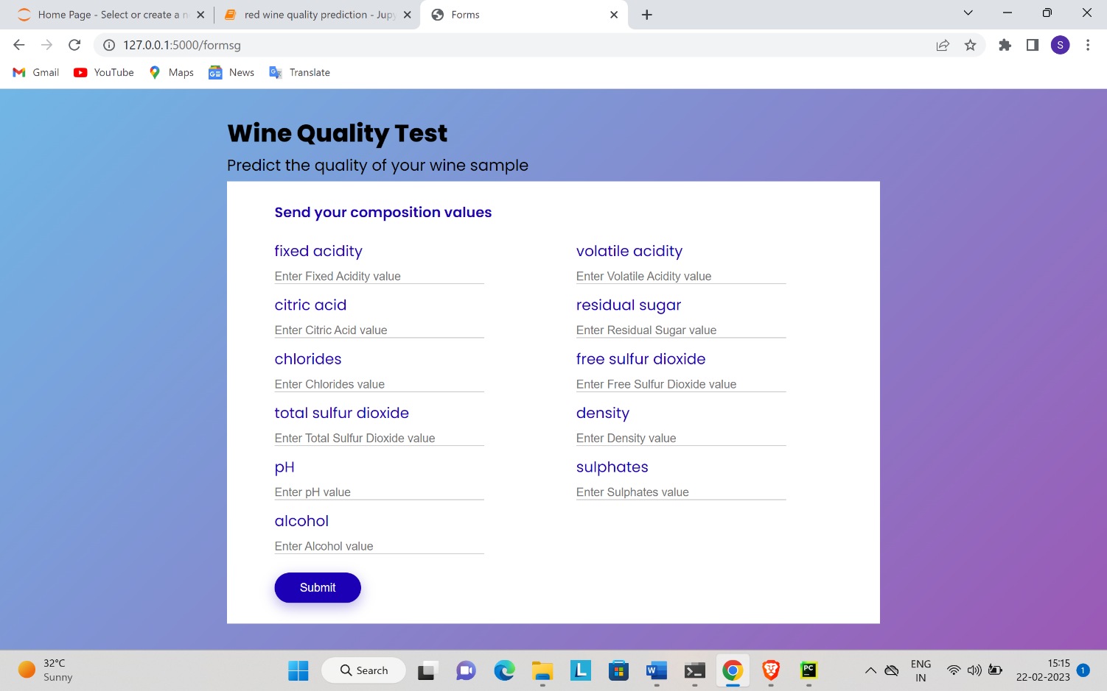

Slide 17
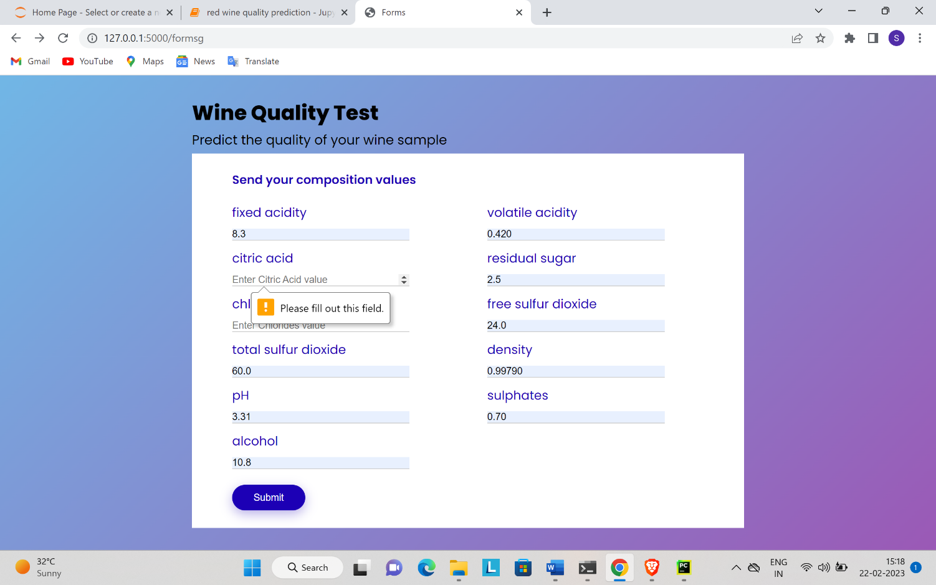

Slide 18


Slide 19
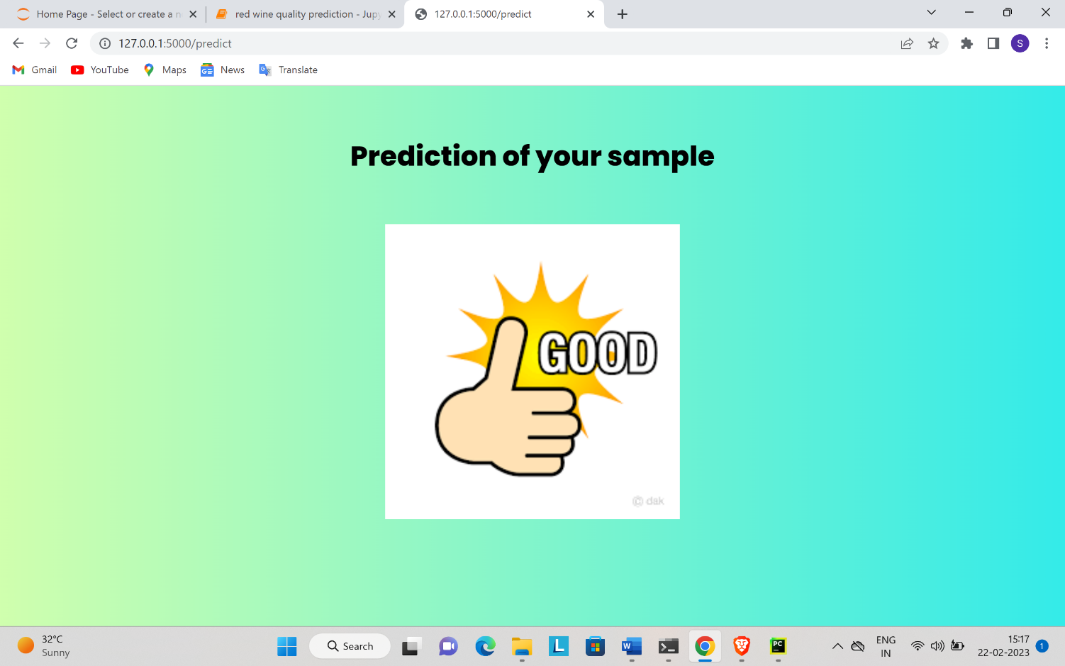

Slide 20
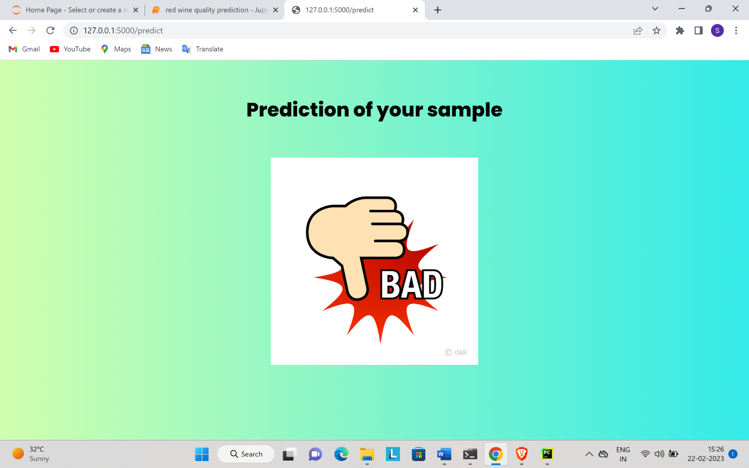

Slide 21
Conclusion & Future Scope
Conclusion
We are able to predict the quality of red wine and to reduce it’s consumption.
Future Scope
To develop more accuracy using machine learning algorithms & advanced techniques.
To improve the red wine quality prediction system.

Slide 22
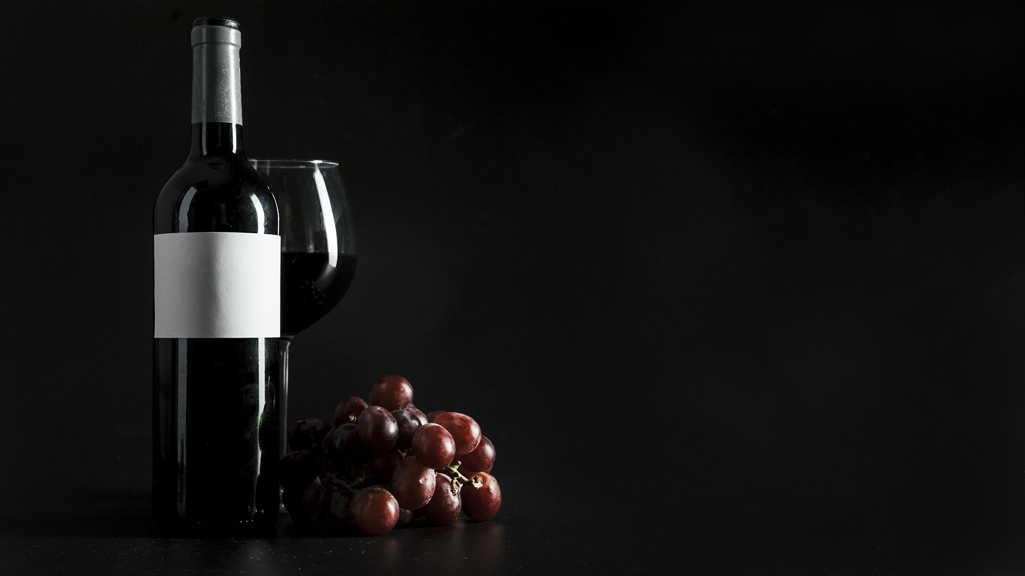
THANK YOU

